Slide 1
Ephesians 5 v 15 - 21
Live like a King’s Kid!

Slide 2
Ephesians 5 15 - 18
Be very careful, then, how you live – not as unwise but as wise, making the most of every opportunity, because the days are evil. Therefore, do not be foolish, but understand what the Lord’s will is. Do not get drunk on wine, which leads to debauchery.

Slide 3
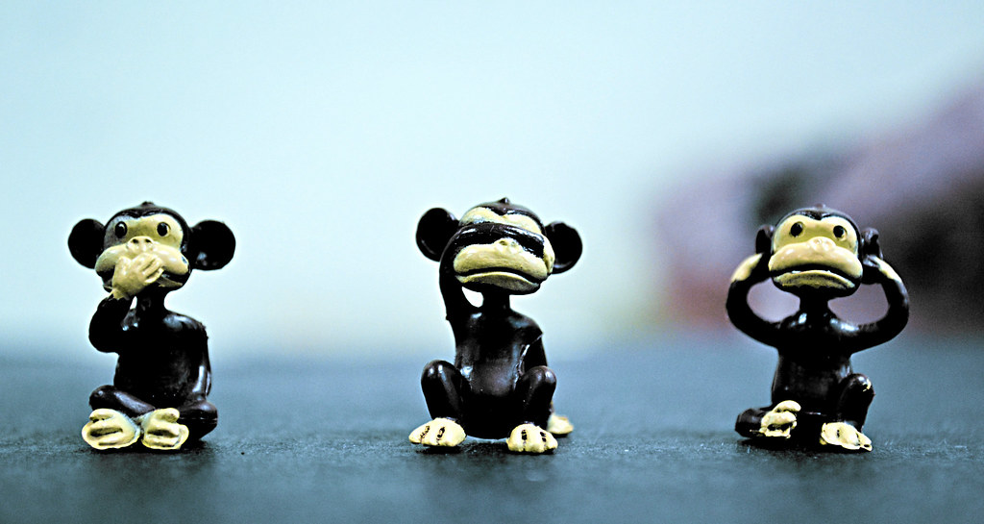
Things I should not do!!

Slide 4
David reminded us from Eph 5 1 -14
Take off
Put on
LIES
ANGER
THEFT
GOSSIP
REVENGE
PROMISCUITY
DRUNKENNESS
TRUTH
PEACE
GENEROSITY
ENCOURAGEMENT
FORGIVENESS
SELF CONTROL
INFLUENCE OF GOD’S SPIRIT

Slide 5
… BUT, HOW DO WE DO THIS?

Slide 6
Ephesians 5 v 18(b) - 21
Instead, be filled with the Spirit. Speak to one another in psalms, hymns and spiritual songs. Sing and make music in your heart to the Lord, always giving thanks to God the Father for everything, in the name of our Lord Jesus Christ.
Submit to one another out of reverence to Christ

Slide 7
I N S T E A D

Slide 8
2 Corinthians 5 :17
Therefore, if anyone is in Christ, the new creation has come. The old has gone, the new is here.

Slide 9
Ephesians 1 v 13, 17, 19 - 20
And YOU ALSO were included in Christ when you heard the word of truth, the gospel of your salvation. Having believed, you were marked in Him with a seal, the promised Holy Spirit…
I keep asking that the God of our Lord Jesus Christ, the glorious Father, may give you the Spirit of wisdom and revelation, that you may know Him better
… and his incomparably great power for us who believe, which he exerted in Christ when he raised him from the dead…

Slide 10
YOU
ARE MARKED WITH THE SEAL OF THE HOLY SPIRIT
WHICH GIVES YOU REVELATION AND WISDOM TO KNOW GOD
AND POWER….YOU HAVE LOTS OF POWER. LOTS.

Slide 11
THE HARDWARE HAS CHANGED:
THE SOFTWARE IS NO LONGER RELEVANT
(Sunny Daniels, earlier this year)

Slide 12
What would Jesus do?

Slide 13
Singing together
  Singing alone
    Being thankful
      Heart attitude
        Elevate others, placing ourselves lower

